Slide 1
Mini Project: Smartwatch
Made by: Alister Rodrigues & P.S. Adithya

Slide 2
Aim: To use the lessons and skills learnt in class to assemble a smartwatch, and gain some experience in building small and cool things

Slide 3
Materials Used
ESP32-S3 Supermini
Heart rate sensor (MAX30102)
Accelerometer/Gyrometer (MPU6500)
Display (ST7735/7789)

Slide 4

Steps Take
1
2
3
4
5
Parts and Features
Code Creation
Prototyping
Full circuit Testing
Assembly
Research of features that can be implemented within the deadline and buying the modules necessary for implementation.
Specifically writing code for testing each module individually before the parts arrive.
Testing and updating the code when testing each module individually till they all worked with satisfying results.
On completion of individual testing, merging all code into one big sketch, and the final round of testing with a couple of updates to flow, features and design.
Soldering them onto a PCB, or a prototyping board for the final watch face.

Slide 5
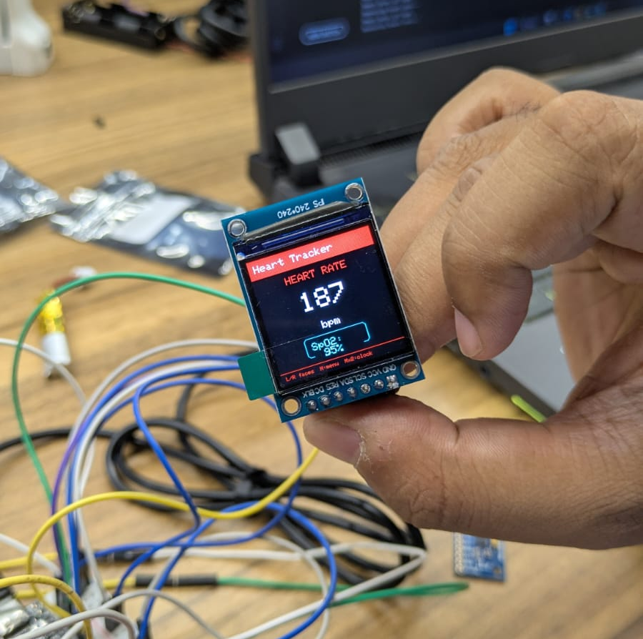
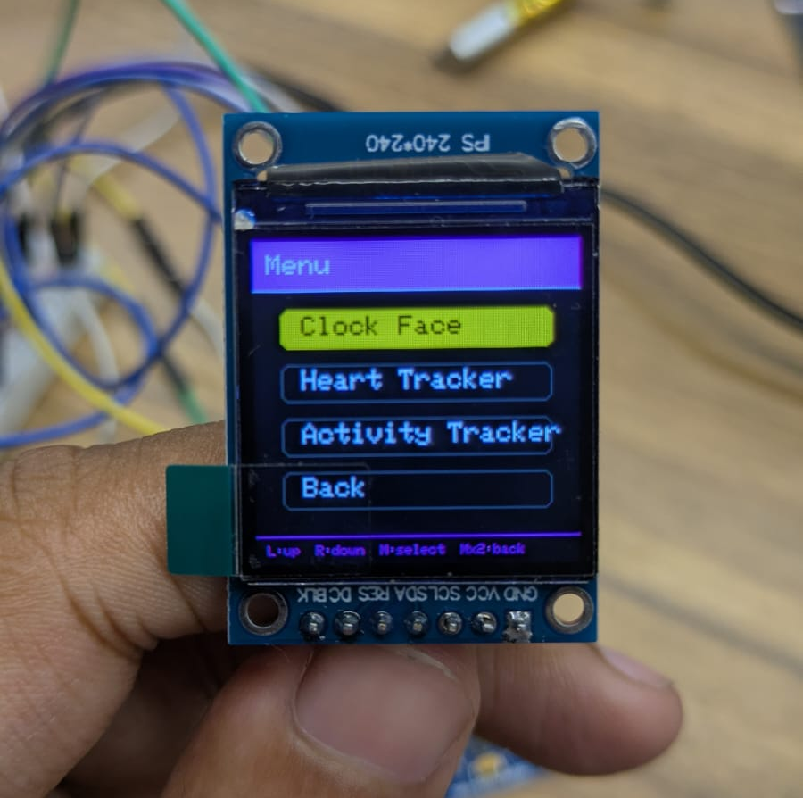
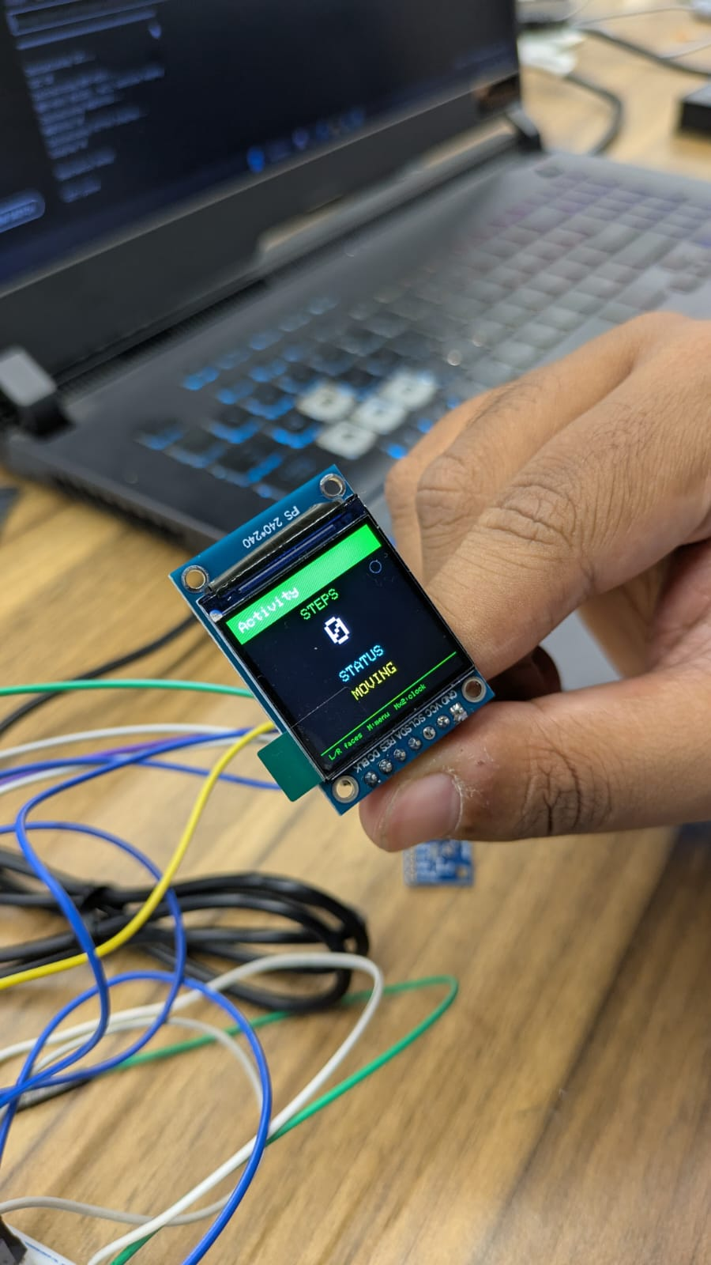
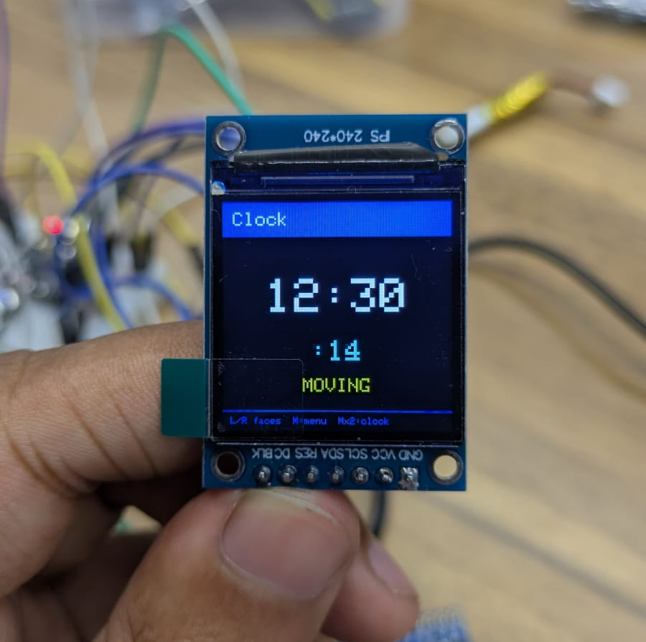
Watch Face
Plainly to display the relevant info from the sensor to the user. Different watch provides information on different features, e.g., Clock, Heart Rate and Step Counter. On a button click, a menu will be dropped down for other functions (currently incomplete). Module used was ST7789

Slide 6
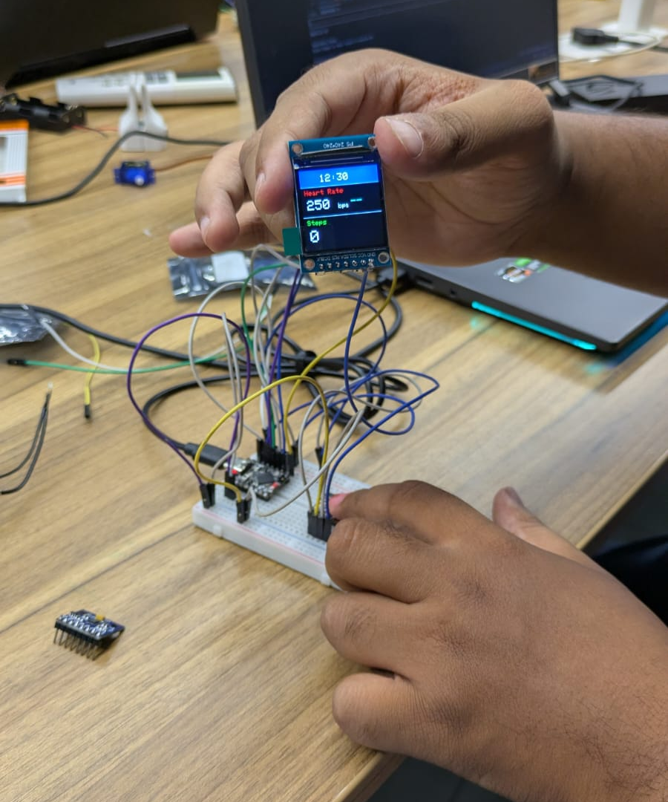
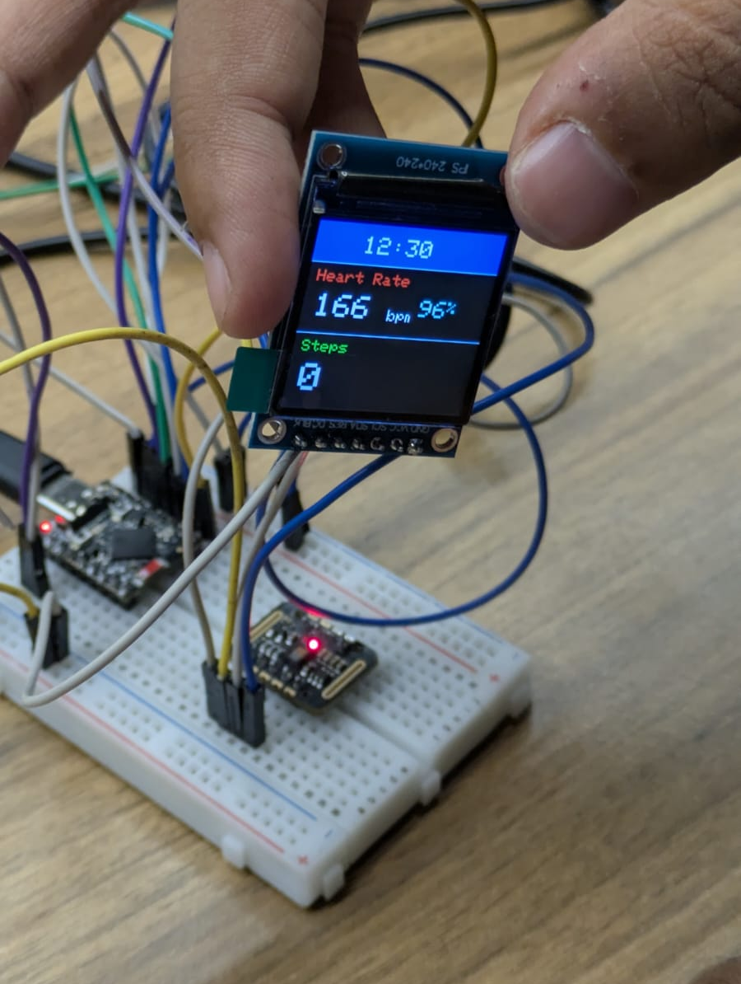
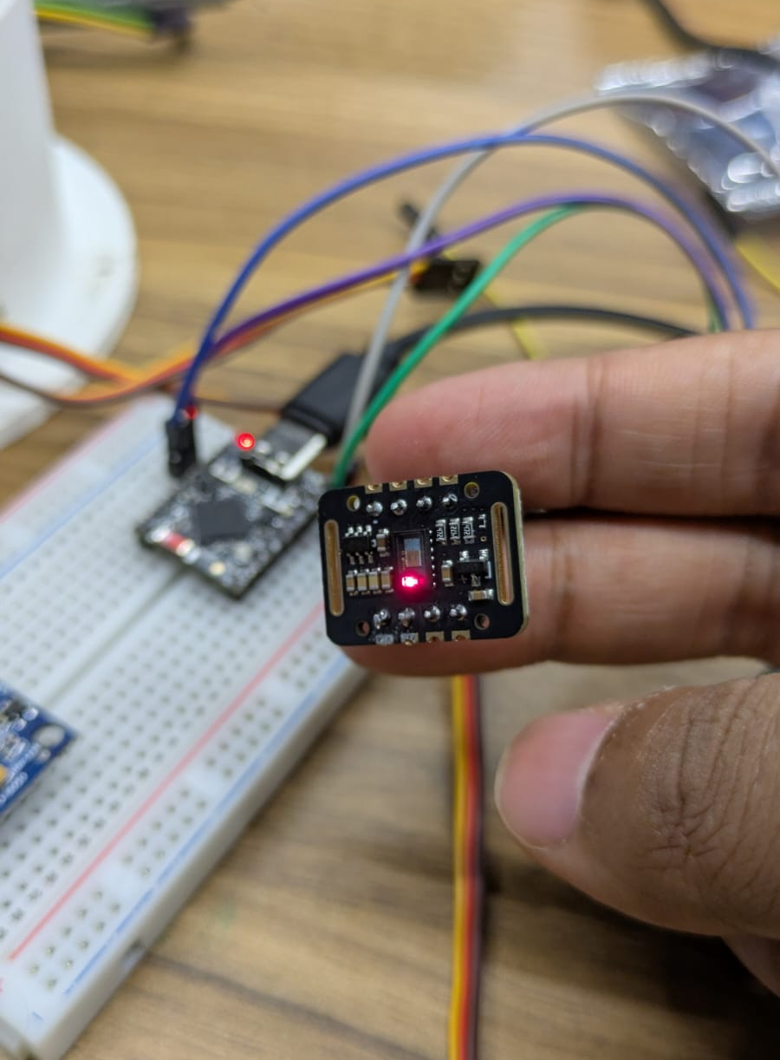
Heart Rate Detection
Utilizing the MAX30102 and a hope to get semi accurate readings (I’m not THAT stressed). The red light is to be covered by our finger/wrist, and the code has undergone multiple iterations to get the closest values.

Slide 7
Step Counter
An MPU6500 accelerometer is used to check for oscillating and quick hand movements that are similar to a person walking. Each complete oscillation is considered 2 steps and is added to the day’s total steps taken

Slide 8
Features and their Working Status
1
2
3
4
Watch Face
Heart Rate
Step Counter
Sleep Tracker
There are different watch faces for showing clock, heart rate and step counter. Also a menu that is activated by a button press
Though inaccurate, it is able to detect a pulse as well as spO2 levels
Checks if the accelerometer speed crosses a threshold and confirms that as a step.
Incomplete due to time constraints.

Slide 9
Potential V2(?)
Mobile connectivity using bluetooth and app for handling persistent storage.
AI integration by either mobile app chat feature or basic prompts in watch face menu.

Slide 10
Thank you!

